Slide 1
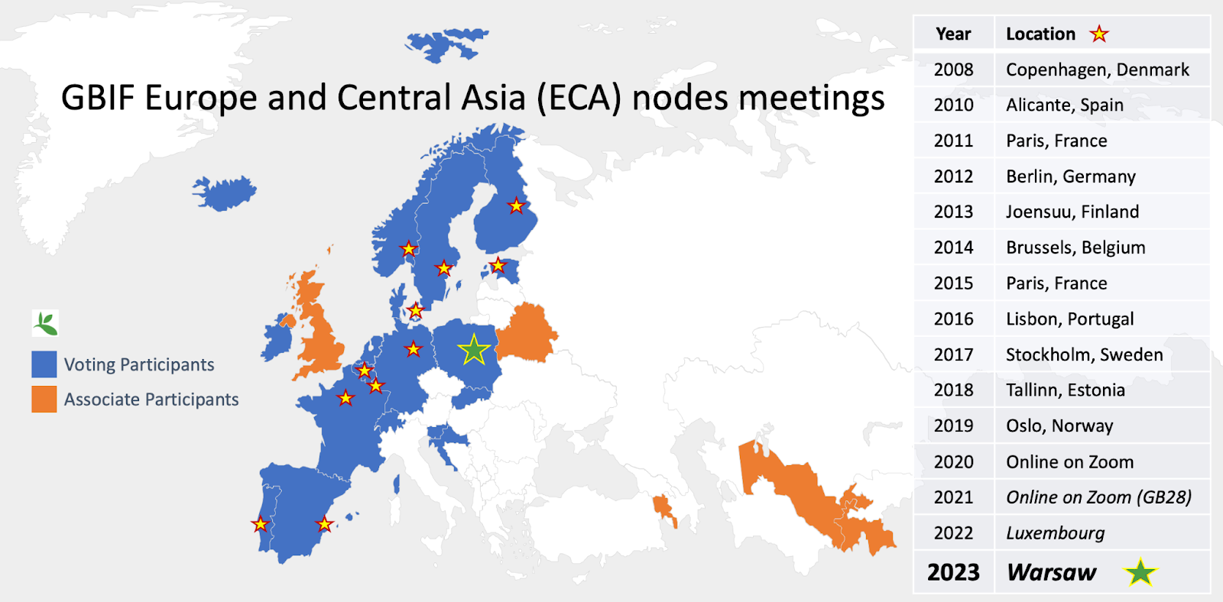




GBIF ECA nodes and European joint educational activity
Notes:
You are here as representatives of GBIF nodes, so well developed, existing and nicely collaborating EU network of research infrastructures.
You speak today a lot about your strategy and how to develop this collaboration further.
So try to imagine your node in 20 years. Even if some of will no be there anymore you are probably able to detrmine key skills that will be needed for further GBIF node development.
Personaly, I also think that collaboration between nodes could be much more effective if you train and educate your future node community together already today.
I was asking some of you about your training activities and all of you are already involved in some training activity here and there. However, standarized, high-level, European master level curricum on biodiversity bioinformatics is not existing.

Slide 2
Erasmus + goals
„… to support, through lifelong learning, the educational, professional and personal development of people in education, training, youth and sport, in Europe and beyond, thereby contributing to sustainable growth, quality jobs and social cohesion, to driving innovation, and to strengthening European identity and active citizenship”
current funding period 2021-2027
key actions:
Key Action 1: Learning Mobility of Individuals
Key Action 2: Cooperation among organisations and institutions, e.g. European Universities
…
up to 2027 50% of European HEI graduates will have mobility experience
Notes:
And this is surprising! Because in EU we are lucky to have better conditions for educational collaboration than else where in the world.
We already have EU funded Erasmus mechanisms on place to suport joint educational initiatives and especially the ones of importance for next generations and he ones supporting already existing research collaboration or infrastructures.
This is also the moment when it is worth to mention that Erasmus of today is much more than what you remember from your studies.
EU is putting different new mechanisms to boost collaboration between Heiger Education Infrastructures.

Slide 3
Erasmus + goals
„… to support, through lifelong learning, the educational, professional and personal development of people in education, training, youth and sport, in Europe and beyond, thereby contributing to sustainable growth, quality jobs and social cohesion, to driving innovation, and to strengthening European identity and active citizenship”
current funding period 2021-2027
key actions:
Key Action 1: Learning Mobility of Individuals
Key Action 2: Cooperation among organisations and institutions, e.g. European Universities
…
up to 2027 50% of European HEI graduates will have mobility experience
Notes:
For example EU decide to create so called european universities that are consortia of several european universities

Slide 4
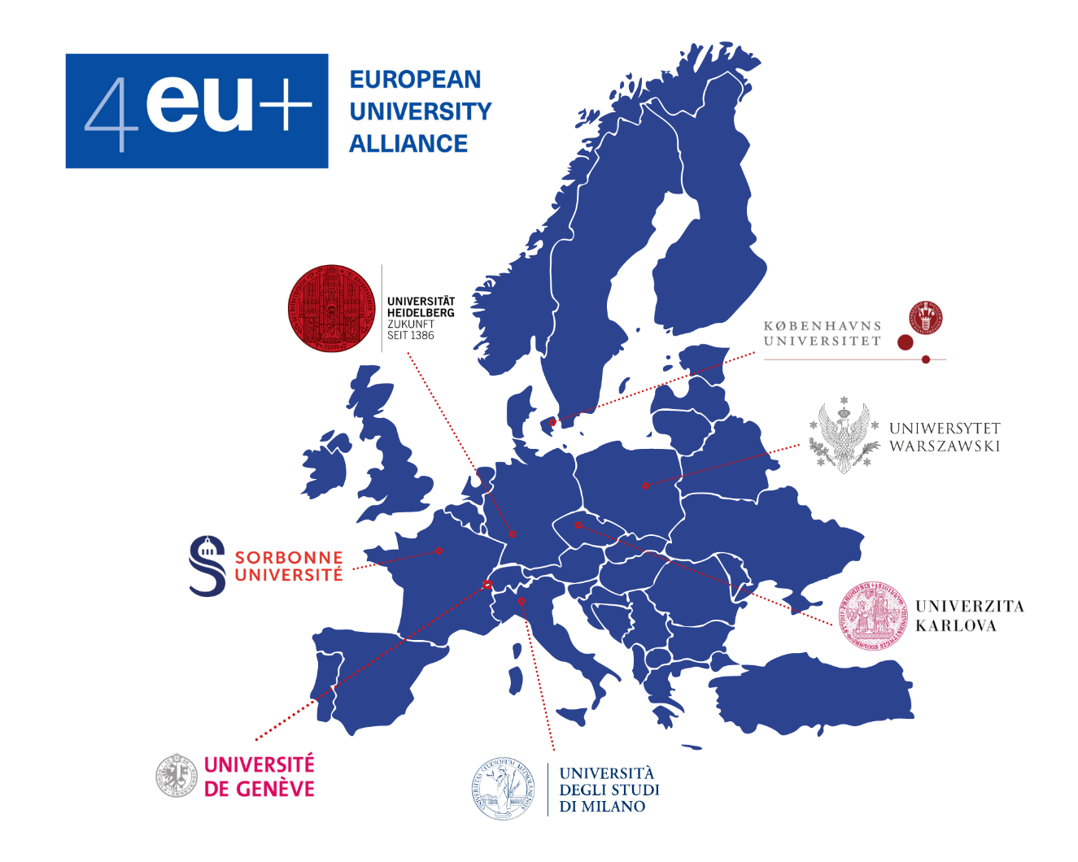
European Universities
INTEGRATION
common infrastructure
common research
common education
community
Notes:
… aimed to have common reseach, infrastructure and education, including study programs. I know that at least one of these european universities, i.e. 4EU+Alliance is planning to create european joint master on biodiversity. But… even independently from such a large initiatives as european universities, Erasmus landscape is much more complex.

Slide 5




Erasmus + opportunities
student, researchers, technicians
student
student
Long-term internship (SMT)
Staff Mobility for Teaching (STA)
Staff Mobility for Training (STT)
Study aborad
Short-term internship
Blended Intensive Program
Joint Master
paralel national registration etc.
6000 euros overheads for organising institution
You can start tomorrow ☺
SIGNED BILATERAL AGREEMENT NEEDED
SIGNED AGREEMENT NEEDED
MIN. 3 PARTNERS
Notes:
Plethora of long and short-term internships possibilities for students, researchers and technicians. These are not only for universities but can be also used for internship in company, NGOs or public institution. No agreement is needed between institution. Only treaining/learning agreements.
For students, from HEIs with signed agreements also blended intensive programs or short term (i.e. ca. 7d long workshops) activities may be developped and funded by Erasmus. These money are easier to get than eg. Cost actions.
Finally, some fullu double degrees or joint curricula may be developed by HEIs that decide to collaborate on creation.
These possibilities may be combined or one can use them step by step to grow from individual ingternship, through joint workshops or summer schools to fully developed joint curricula.

Slide 6

Erasmus + „individual exchange box”
up to 5 days
max. 2 per year
min. 8 teaching hours per week
based on acceptance from receiving institution
study abroad
staff mobility for teaching (STA)
60-180 days
no interinstitutional agreement needed; individual
in any HEI, also outside of EU
Learning Agreement and transcript of records
continuous recruitment
long-term Internship (SMT)
short-term internship (SMTs)
staff mobility for training (STT)
up to 5 days
also for technical staff
max. once a year

Slide 7

Individual exchange with institutional agreements
7 days
only at partner universities with signed agreements
mandatory virtual component (not for PhD level)
min. 3 ECTS
must be coordinated by supervisor/teacher
great for summer schools
only at partner universities with signed BILATERAL agreements
student participates in regular courses
30 ECTS per semester must be provided
recruitment once a year February/March
study abroad
staff mobility for teaching (STA)
long-term Internship (SMT)
short-term internship (SMTs)
staff mobility for training (STT)

Slide 8


Individual exchange with institutional agreements
7 days
only at partner universities with signed agreements
mandatory virtual component (not for PhD level)
min. 3 ECTS
must be coordinated by supervisor/teacher
great for summer schools
only at partner universities with signed BILATERAL agreements
student participates in regular courses
30 ECTS per semester must be provided
recruitment once a year February/March
study abroad
staff mobility for teaching (STA)
long-term Internship (SMT)
short-term internship (SMTs)
staff mobility for training (STT)

Slide 9

Organised short term exchange with institutional agreements
15-40 participants
5 days + mandatory virtual component
only at partner universities with signed agreements
min. 3 partners
min. 3 ECTS
organized activity, e.g. summer school
UW as partner
unlimited
UW as organizer
4 per year at UW
6000 eur overheads for organizer
Blended Intensive Programme (BIP)
study abroad
staff mobility for teaching (STA)
long-term Internship (SMT)
short-term internship (SMTs)
staff mobility for training (STT)

Slide 10
Biodiversity, ecology evolution Joint Master idea
Motivation
Although there is a growing international interest in biodiversity changes, already reflected in several strategic documents, the skills needed for biodiversity data analysis are frequently not included in the biological academic curricula. To mitigate these limitations, we want to educate biodiversity researchers and policymakers of the future.
Goal
to create top-level „biodiversity, ecology, and evolution” Master level program, including:
education on common biodiversity monitoring standards and methods beyond the national borders,
profiting from a wide range of experts from different universities,
using modern analytical tools, often needing an interdisciplinary approach,
in an international environment.

Slide 11
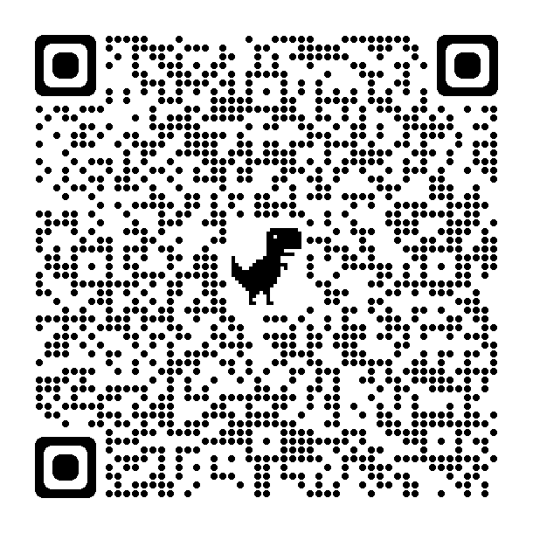
Let’s imagine
European Biodiversity Erasmus Mundus Joint Master
General framework
2 years long
120 ECTS credits
English-taught Master of Science program
including a mandatory mobility for students
open to students from all over the world
More on Erasmus Mundus Joint Master call

Slide 12
Let’s imagine
European Biodiversity Erasmus Mundus Joint Master
General framework
2 years long
120 ECTS credits
English-taught Master of Science program
including a mandatory mobility for students
open to students from all over the world
Can we have GBIF related module as an element of such a program?
setting standards in biodiversity research and education
community integration
…
More on Erasmus Mundus Joint Master call
Notes:
So, what do you think about such an idea? Are your nodes willing and ready to be involved in development of joint biodiversity related curriculum in EU? Any ideas?

